Slide 1
Orioles Stat Tracker
Nathan Ellis and Cortez Black

Slide 2
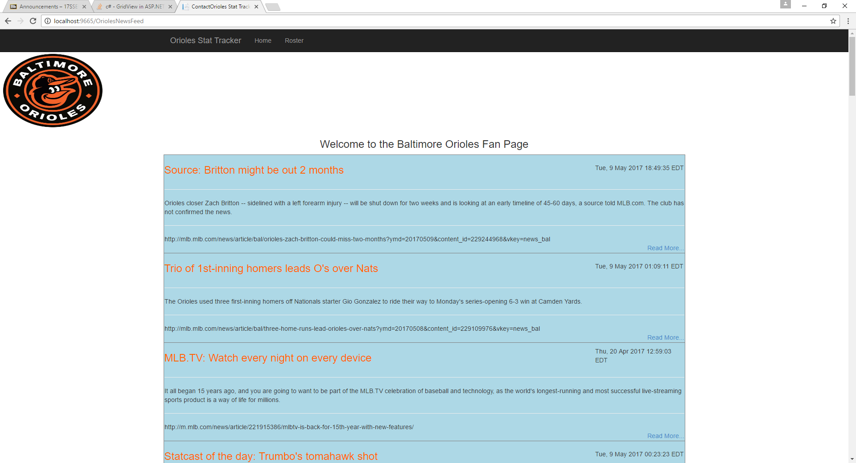

Slide 3
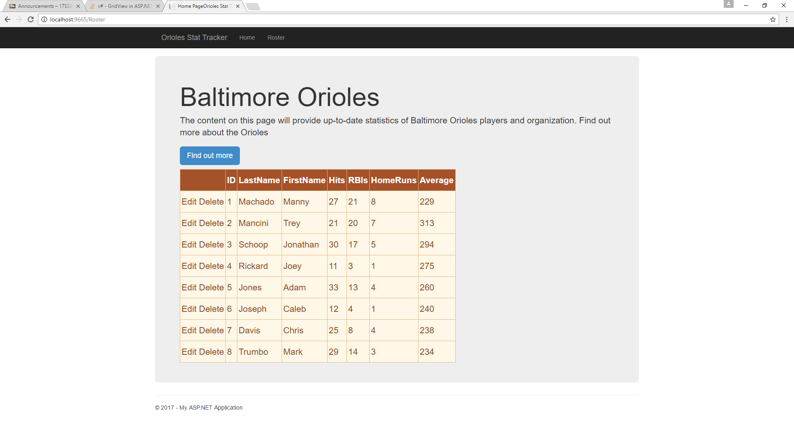

Slide 4
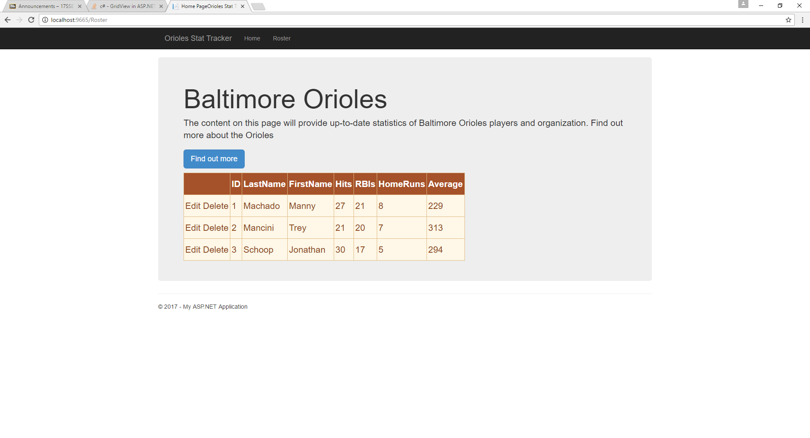
Deleting

Slide 5

Editing

